Slide 1
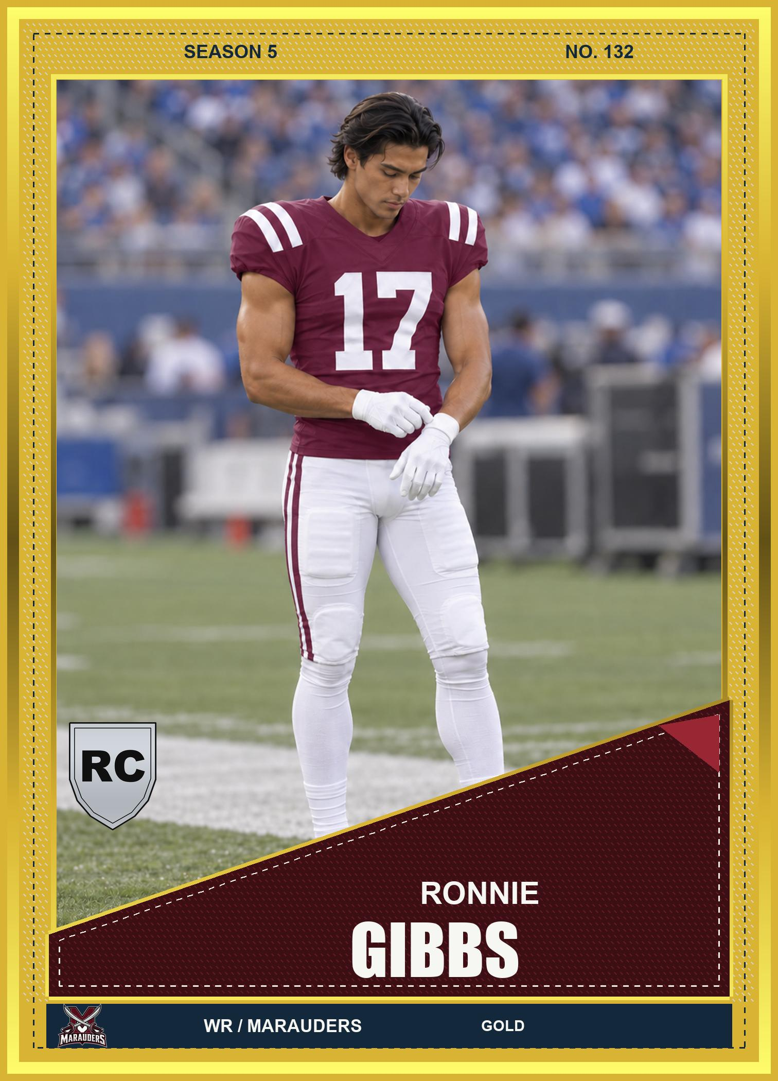
FANTASY FOOTBALL
CARD EXCHANGE
Every card.
A new Sunday.
Obscure Gambit / A first look
Notes:
Single-player American football card collecting and fantasy simulation. The cover card is an artwork preview, not a claim about a captured rookie career. Source: marketing-site/dist/assets/ronnie-gibbs-rookie-v18.jpg.
Prepared September 27, 2026. Product claims: docs/marketing/01-positioning.md. Visuals are project-owned card artwork and development previews, not a record of a complete player session.

Slide 2
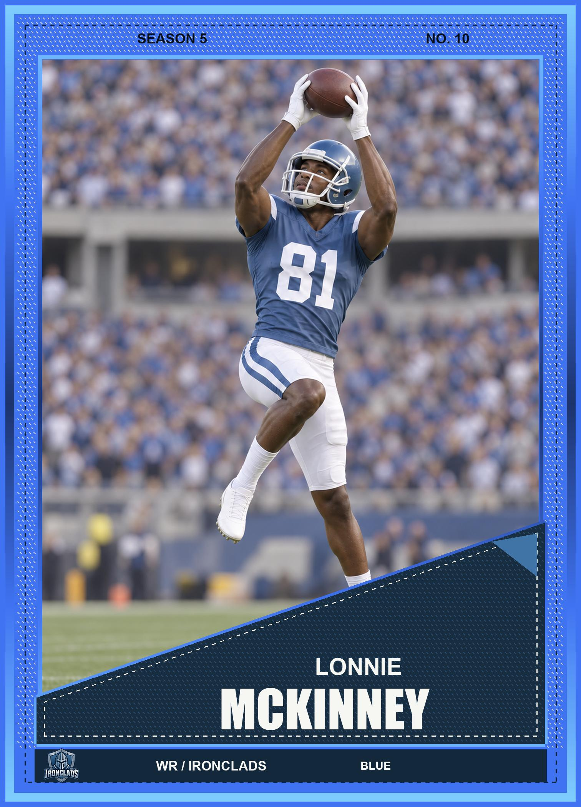
A great pull is just the beginning
Collect your favorites.
Open packs and build a collection around a player, a team, or a set.
Consider your next move.
Keep a card, list a duplicate, or work on a trade.
02
Notes:
Core pack/collection loop: docs/GDD.md; trading: docs/Collection-and-trade-controls.md. Card artwork source: marketing-site/dist/assets/lonnie-mckinney-blue-v18.jpg.
Prepared September 27, 2026. Product claims: docs/marketing/01-positioning.md. Visuals are project-owned card artwork and development previews, not a record of a complete player session.

Slide 3

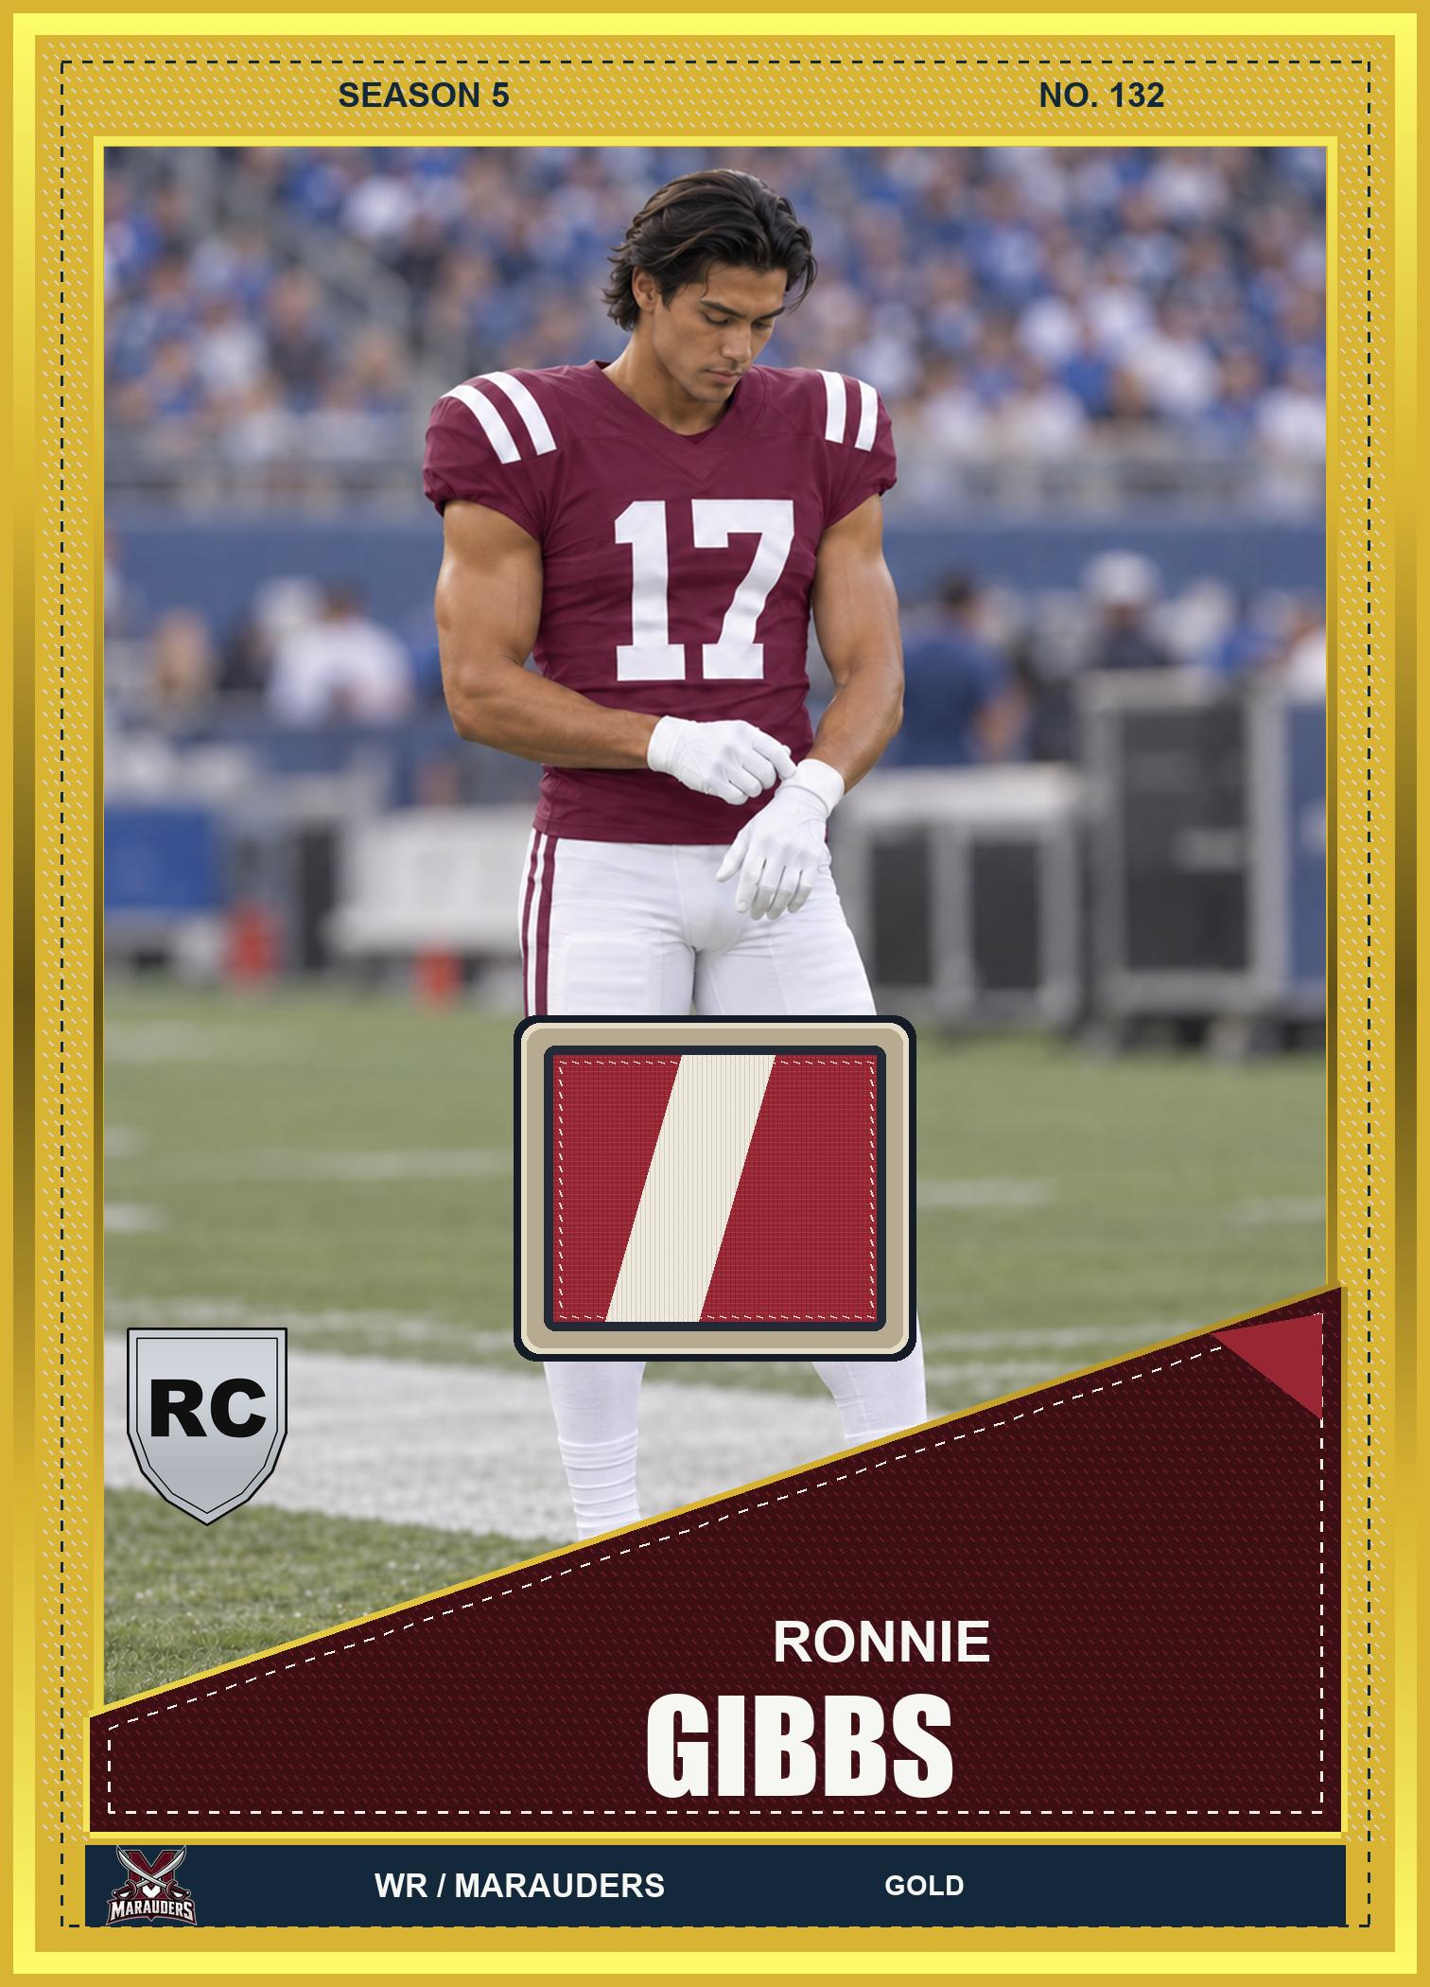
The card your binder is missing
Numbered cards.
Rare parallels.
Autographs and patches.
Build a collection with favorites of your own.
03
Notes:
Autograph and patch artwork previews from marketing-site/dist/assets (current v18 Ronnie Gibbs variants). Rarity and insert support: Core/ValuationEngine.cs. Designs may change.
Prepared September 27, 2026. Product claims: docs/marketing/01-positioning.md. Visuals are project-owned card artwork and development previews, not a record of a complete player session.

Slide 4
Your collection shapes your lineup
Own the card.
Choose the player.
Select eligible players from your collection for fantasy competitions. Follow their games and see how your lineup performs.
04
Notes:
Eligibility verified in UnityProject/Assets/Scripts/GameManager.FantasyLineupBuilder.cs and Core/DailyFantasyService.cs. Eligibility varies by competition. This text slide does not present a mockup as gameplay.
Prepared September 27, 2026. Product claims: docs/marketing/01-positioning.md. Visuals are project-owned card artwork and development previews, not a record of a complete player session.

Slide 5
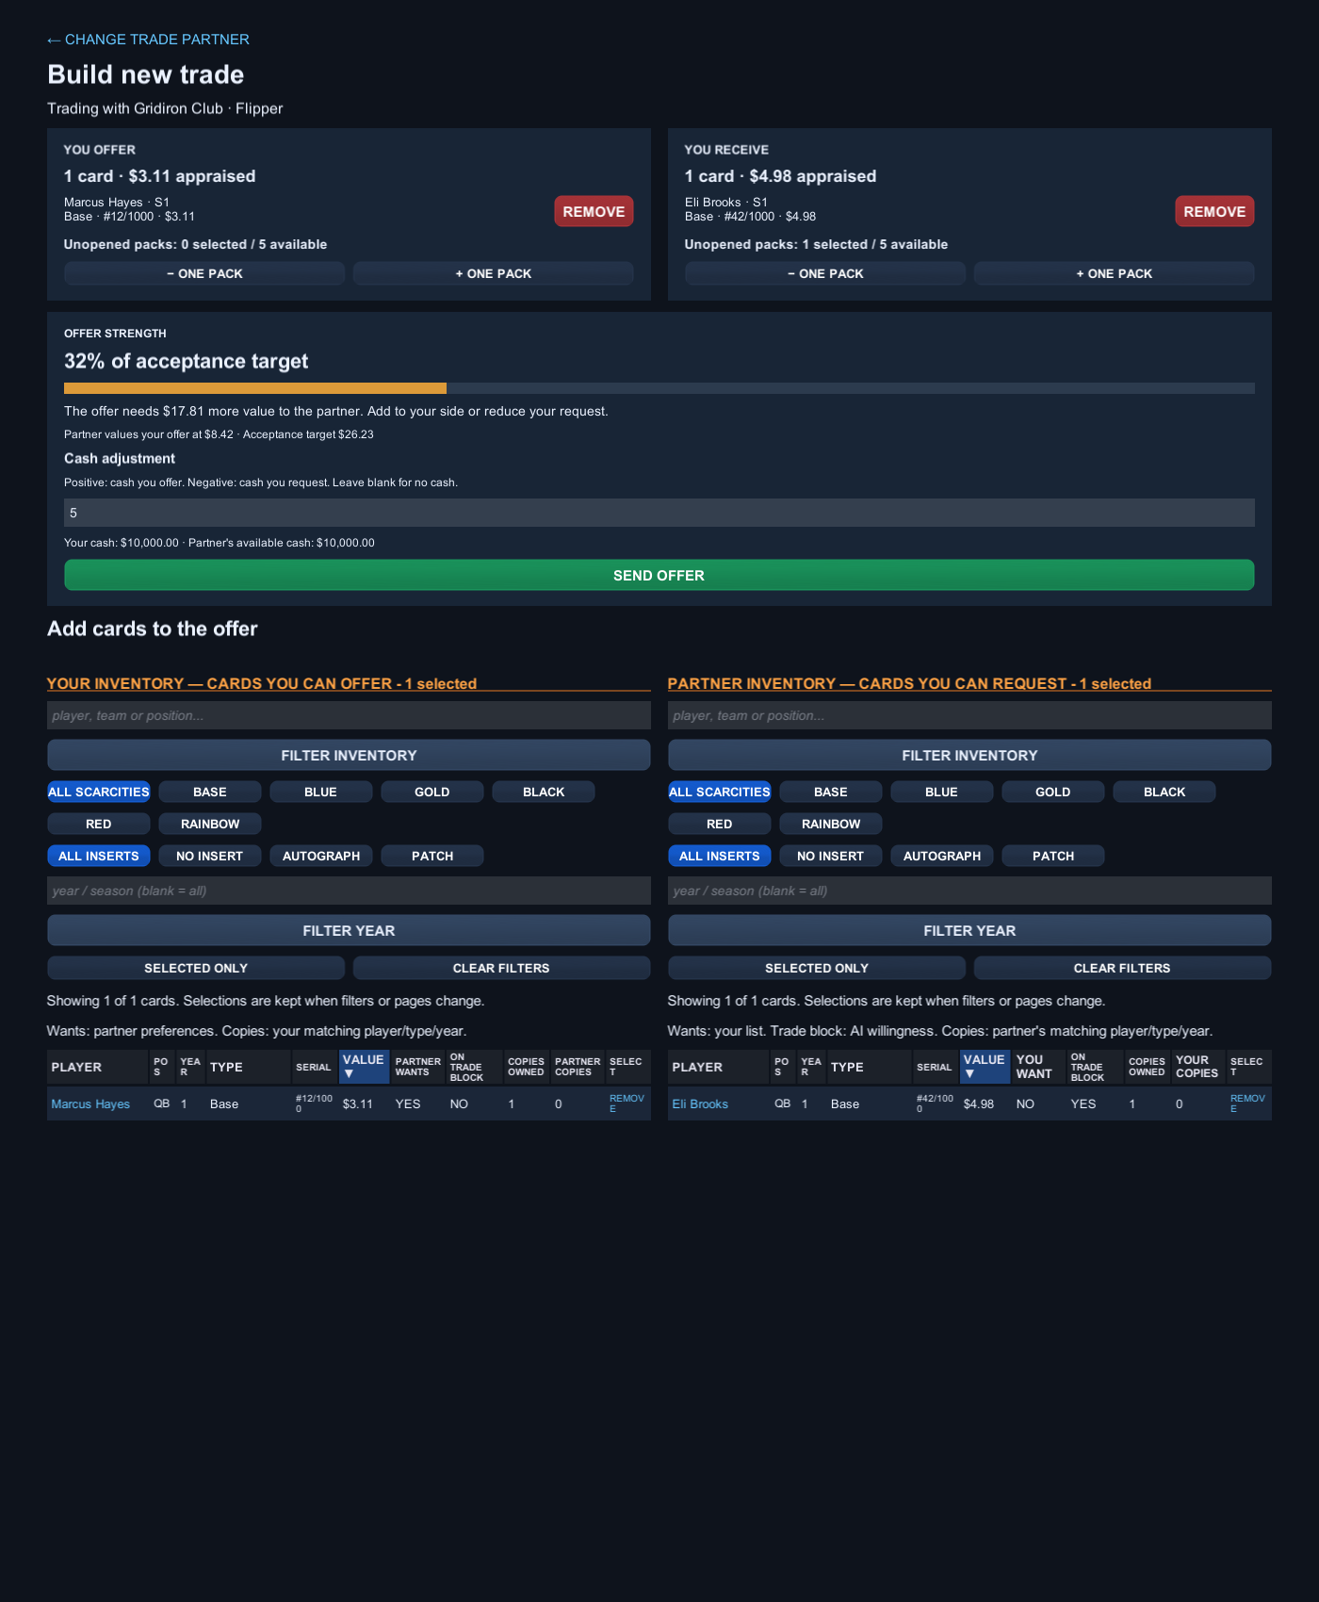
A trade worth thinking about
Research a prospect.
Find a collector with
different priorities.
Decide what you are willing
to give up.
Development preview
05
Notes:
Image: output/TradePreview/trade-builder.png. This offer has not been accepted; it demonstrates a decision, not a successful trade. Collector controls: docs/Collection-and-trade-controls.md.
Prepared September 27, 2026. Product claims: docs/marketing/01-positioning.md. Visuals are project-owned card artwork and development previews, not a record of a complete player session.

Slide 6
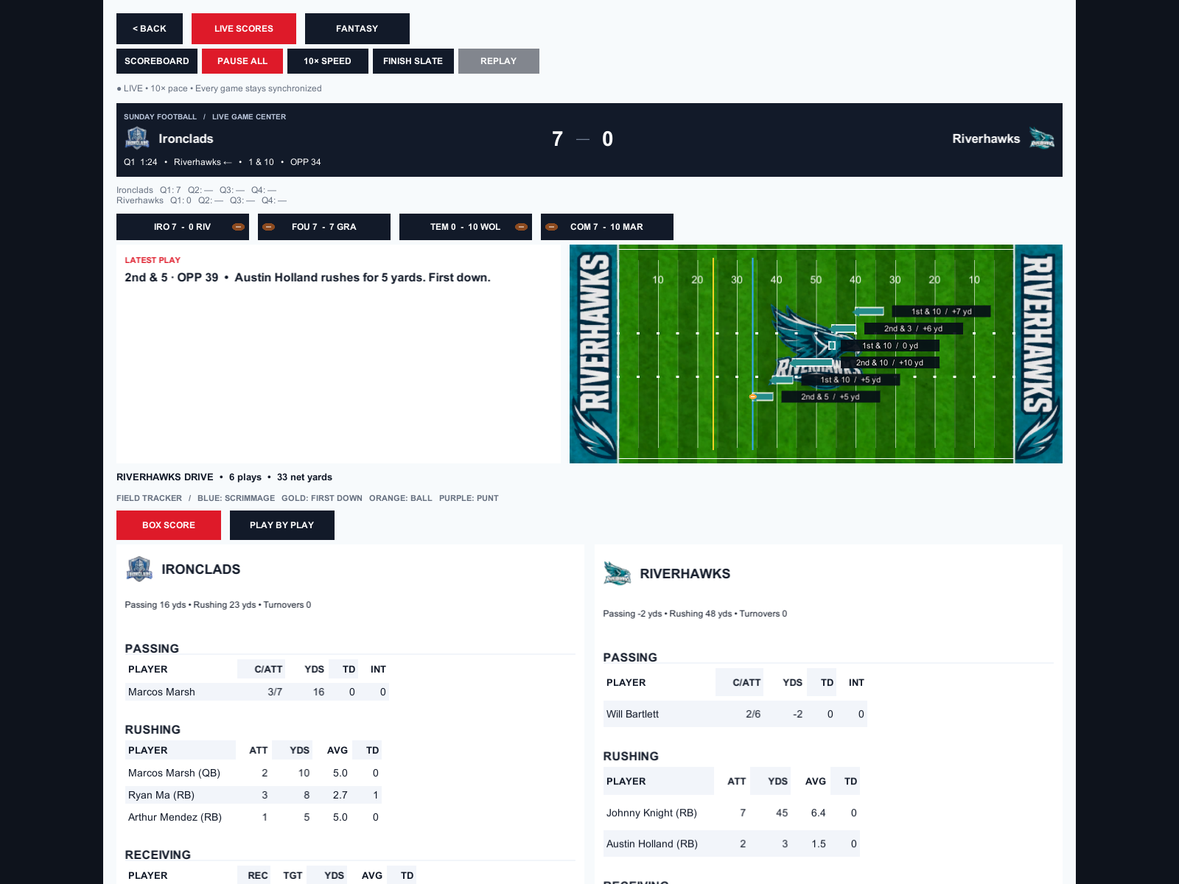
See what Sunday brings
Follow simulated games.
Track fantasy results.
Watch careers develop.
A fictional league with
its own players and seasons.
Development preview
06
Notes:
Image: output/SundayPreview/sunday-game-center.png. Schematic replay of simulated games, not on-field player control. Source: docs/Game-viewer.md.
Prepared September 27, 2026. Product claims: docs/marketing/01-positioning.md. Visuals are project-owned card artwork and development previews, not a record of a complete player session.

Slide 7
What will your collecting story be?
Follow a rookie.
See how a prospect develops across a season.
Finish your set.
Find the card that fills the last empty space.
Build around your favorites.
Look for eligible players who fit your fantasy plans.
07
Notes:
Suggested play and coverage angles. No guarantee of a breakout, completed set, or fantasy win. Collection goals supported by docs/Set-rewards.md; player progression by docs/Progression-balance-update.md.
Prepared September 27, 2026. Product claims: docs/marketing/01-positioning.md. Visuals are project-owned card artwork and development previews, not a record of a complete player session.

Slide 8
Your next collection starts here
Buy once.
Collect with
in-game currency.
No real-money pack purchases.
Obscure Gambit / Target launch: January 2, 2027
08
Notes:
One-time purchase and no paid packs confirmed by Josh. Launch target January 2, 2027 confirmed by Josh. Contact: Josh@ObscureGambit.com. Price, public demo and Steam URL remain unconfirmed. This first-look deck intentionally has no invented contact or link.
Prepared September 27, 2026. Product claims: docs/marketing/01-positioning.md. Visuals are project-owned card artwork and development previews, not a record of a complete player session.

